Slide 1

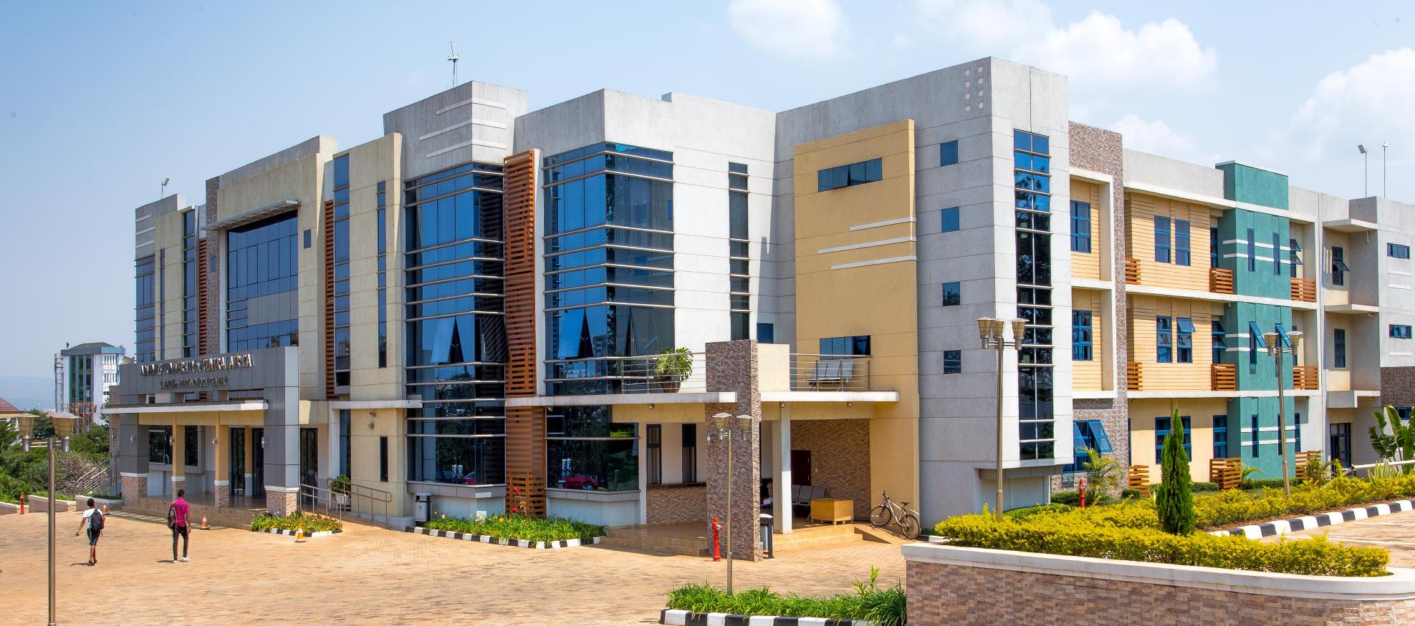
12th September, 2025
INSY 8311 Database Development with PL/SQL

Slide 2
Single Row Functions
SELECT UPPER(first_name), LENGTH(last_name) FROM employees;
-- Uppercase conversion and string length.
SELECT ROUND(salary, 0), TRUNC(salary, 0) FROM employees;
-- Round vs. truncate numeric values.
SELECT hire_date, ADD_MONTHS(hire_date, 6) FROM employees;
-- Date arithmetic example.
SELECT TO_CHAR(hire_date, 'YYYY-MM') FROM employees;
-- Format hire dates.

Slide 3
Handling NULLs & NVL
SELECT NVL(commission_pct, 0) FROM employees;
-- Replace NULL with 0.
SELECT NVL2(commission_pct, 'Yes', 'No') FROM employees;
-- Conditional output based on NULL.

Slide 4
Conditional Logic with CASE
SELECT salary,
CASE
WHEN salary > 10000 THEN 'High'
WHEN salary BETWEEN 5000 AND 10000 THEN 'Medium'
ELSE 'Low'
END AS salary_level
FROM employees;
-- Categorize salary using CASE expression.

Slide 5
Aggregate Functions
SELECT COUNT(*), AVG(salary), MAX(salary), MIN(salary), SUM(salary) FROM employees;
-- Aggregate summary.
SELECT job_id, COUNT(*) FROM employees GROUP BY job_id;
-- Group employees by job.

Slide 6
Grouping and HAVING
SELECT department_id, AVG(salary) FROM employees GROUP BY department_id;
-- Average salary per department.
SELECT department_id, COUNT(*) FROM employees GROUP BY department_id HAVING COUNT(*) > 5;
-- Groups with more than 5 employees.

Slide 7
Real World Queries
1. Show job_id and average salary for jobs where average salary is more than 7000.
2. List departments with more than 5 employees and average salary over 8000.

Slide 8
Quiz (10 Marks)
1. Show jobs and how many employees have that job.
2. Write a query to show average salary by department, but only if average salary > 6000.
3. Count number of employees without commission.
4. List employees with salary categorized as 'Low', 'Medium', or 'High'.
5. Show total salary and average commission for each department.

